Slide 1


EXCEL PROJECT
Astrosage Dataset Analysis
Project by
Aminesh Kumar Singh

Slide 2
PROBLEM STATEMENT
AstroSage has received a 1 crore investment and aims to optimize its call center
operations. The goal is to determine how to allocate this investment to maximize
operational efficiency, customer satisfaction, and profitability. The analysis will
consider historical call data, performance metrics, and market trends to make
informed decisions.

Slide 3
OBJECTIVE
The primary goal is to provide a comprehensive and data-driven
view to stakeholders.
Analyze data to gain insights and key patterns.
Provide suggestions for user satisfaction and effectiveness in
good service.
Provide investment strategies in training programs, technology
updates and hiring.

Slide 4
METHODOLOGY
ANALYSIS OF DATA : Data is analyzed for KPI’s and other important metrics.
DATA CLEANING: The raw data is cleaned by different excel functions.
Missing values are been filled and formatting is done.
DASHBOARD: Whole data is summarized in the form of dashboard.
KEY INSIGHTS : Provide suggestions on the basis of insights for customer
satisfaction and profitability boost.

Slide 5
OVERVIEW
Key Performance Indicators (KPIs)
Service Requests : Over 26K monthly users.
Gurus: 131 dedicated gurus.
Revenue: Monthly revenue over 2 lakhs.
Investment: 1 crore investment for business optimization.
Data Cleaning and Preprocessing
Attribut Removal: Removed non-informative columns.
Data Consistency: One to One mapping for Guru name & GuruIDs.
Data Cleaning: Combining columns Removed unwanted characters and
handled missing values optimization
Data Utilization
Business Analysis: Deep dive into AstroSage's business model.
Key Insights: Understand user behavior, internal challenges,
and areas for improvement.
Investment Guidance: Identify strategic areas for resource allocation.

Slide 6
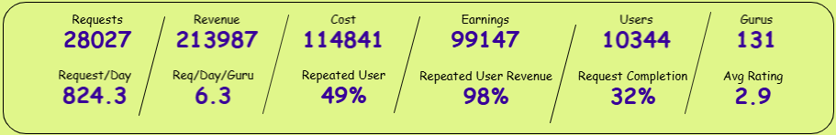
KPIs
Received a total of 28027 requests served by 131 Gurus in a span of 34 days.
Generated revenue of 2.1L with whooping profit of 99K.
Call completion rate is only 32% which is alarming.
Likewise Customer satisfaction score is as low as 2.9 which is below average.
Getting average of 250 requests per day which means approximately 2 requests are handled per guru per day. Indicating customer traffic is really low.
49% customer retention rate is considered good and they contribute to 98% of revenue. Hence, higher customer retention will boom the revenue significantly.

Slide 7

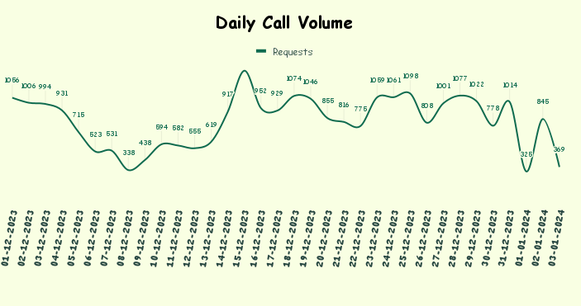
DAY WISE REQUESTS ANALYSIS
Requests : Total of 28027 with avg of
250/day & 1.9/day/Guru, indicating low activity.
Potential Issue: Suggests low user base or traffic.
Compounding Problem: Declining call volume highlights business risks.
Urgent Action: Sustained decline poses critical challenges.
Temporary Solution: Boost marketing and offer incentives.

Slide 8
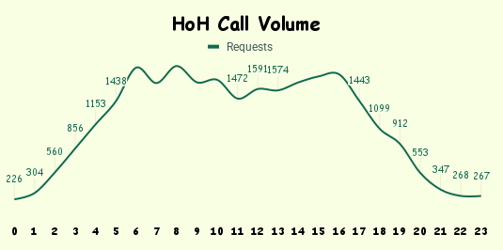
HOURLY TRAFFIC ANALYSIS
Peak Hours: Daily traffic peaks between 6 AM and 4 PM.
Business Importance: This time period is crucial for the business.
Skill Requirement: Highly skilled professionals needed for optimal customer satisfaction.
Solution: Flexible staffing and shift optimization for efficient workload distribution.

Slide 9
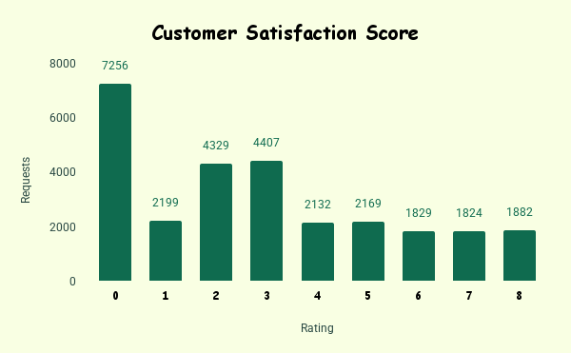
CUSTOMER SATISFACTION ANALYSIS
Key Insights:
7256 times Guru gets the rating of 0.
Avg rating is 2.9, which is low overall rating.
Fewer gurus in ratings 5-8, indicating improvement potential.
Few gurus achieve top ratings.
Recommendations:
Provide training for gurus with ratings 2-4 to improve interactions.
Introduce performance-based incentives for higher ratings.

Slide 10
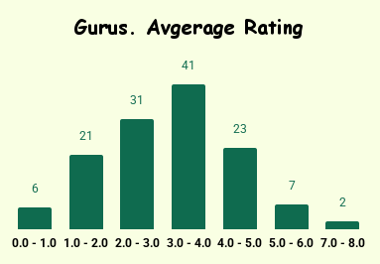
GURU PERFORMANCE ANALYSIS
Key Insights:
6 Gurus have avg rating <1 , i.e. Poor performing.
Only 9 have avg ratings > 5
Majority of Gurus have ratings between 2 to 5.
Overall Avg rating is 2.9, which is low.
Fewer gurus in ratings 5-8, indicating improvement potential.
Recommendations:
Provide training for gurus with ratings <4 to improve interactions.
Introduce performance-based incentives for higher ratings.

Slide 11
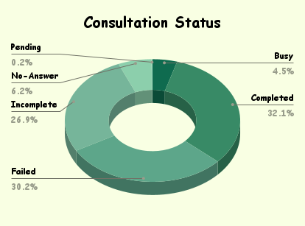
CONSULTATION TYPE ANALYSIS
Key Insights:
Low Success Rate: Only 32% of requests are successfully completed.
High Failure Rates: Over 57% request are either Incomplete or failed and rest 11% belong to other logs.
Improvement Areas: Address issues with "No Answer," "Busy", “Incomplete” and "Failed" calls.
Recommendations:
Improve Support Processes: Upgrade systems, train staff, reduce response times, Implement automated callbacks..
Enhance Queue Management: Expand agent availability or improve call routing.

Slide 12
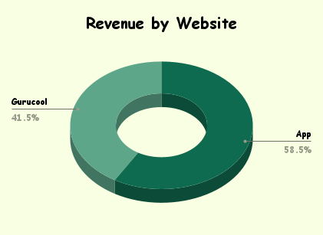
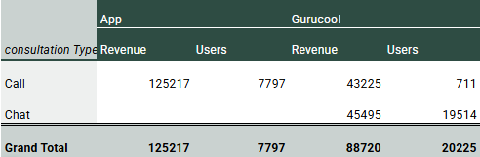
WEBSITE ANALYSIS
Key Insights
Activity : 72 % requests on Gurucool website whereas only 28 % of them were on App.
Revenue : 58.5 % of revenue comes from App despite significant lower activity compared to Gurucool.
Consultation : For Calls users prefer App over Gurucool, whereas Chat services are only available on Gurucool.
Suggestions
Introduce chat services on Apps as well as its more profitable platform and currently has lower customer base.

Slide 13
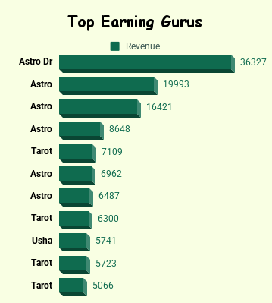
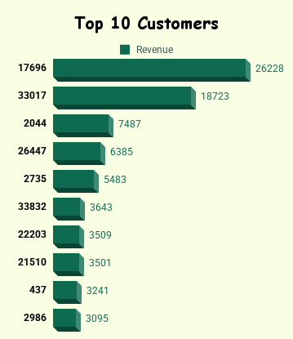
TOP GURUS & TOP USERS ANALYSIS
Key Insights
Total of 131 Gurus, generated revenue of 214K, from 28027 requests, with rating average of 2.9 .
Top 10 Gurus contributed 120k(56%) of total revenue, from 8312(30%) requests, with avg rating of 3.3 .
Key Insights
Top 10 users have made 567(2%) of total requests and contributed 81k(38%) of total revenue, with an average satisfaction score of 3.5.
Suggestion
Address issues with "No Answer," "Busy", “Incomplete” and "Failed" calls.
Offering free and complimentary chats and calls to expand customer base.
Suggestion
Professional development and training.
Clear performance metrics.
Recognition and reward.
Upgrade technology and tools.

Slide 14
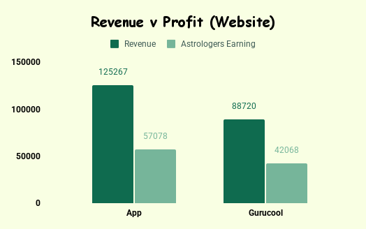
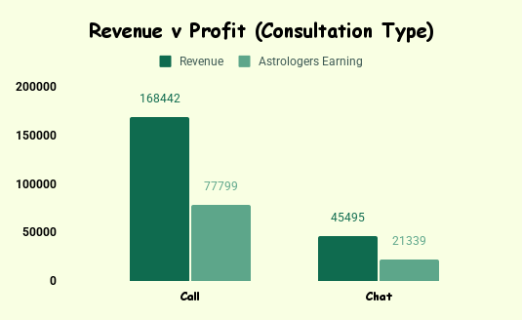
REVENUE & PROFIT ANALYSIS
Key Insights
Both App & Gurucool are Significantly Profitable.
Both Call & Chat service sare Significantly Profitable .
Calls Generated higher revenue compared to Chat services.
App generates more revenue compared to Gurucool.
Suggestions
Chat Services need to be monetized in better way. As revenue generation is low.

Slide 15
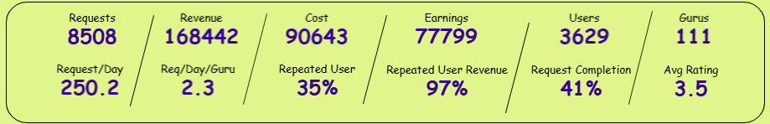
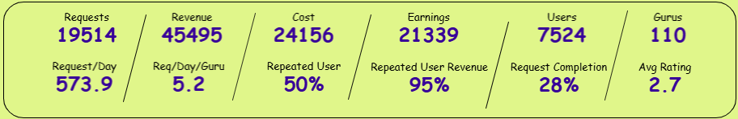
CHAT vs CALL ANALYSIS
Key Insights
31% were Call requests & 69% were Chat requests.
Revenue and Profits from Calls is much higher compared to Chats.
Likewise Customer Satisfaction Rate is is higher for Calls(3.5) wrt Chats(2.7).
Average Activity per day is low for both the services.
Completion rate of Calls(41%) is better than Chat(28)
User base is for Calls(3629) is smaller in comparison with Chats(7524)
Suggestions
Need training and improvement in Chat services completion rates.
For call services, should work on expanding users base, as this service brings higher revenue and profits.
Calls
Chats

Slide 16
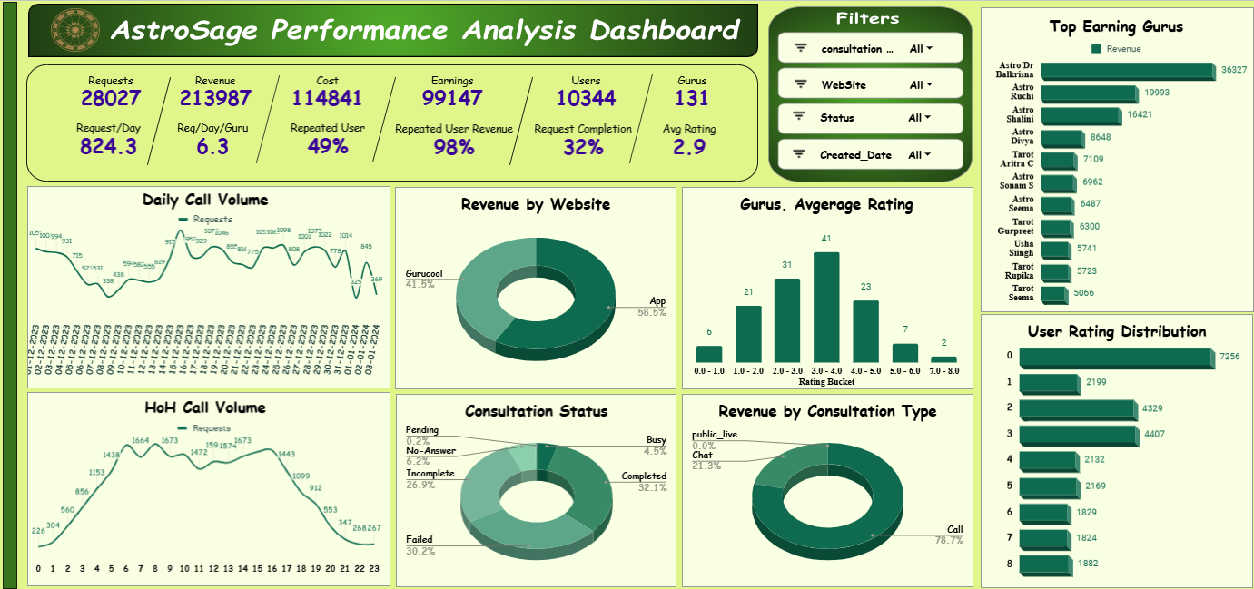
DASHBOARD

Slide 17

RECOMMENDATIONS
AFTER ANALYZING ALL THESE INSIGHTS I RECOMMEND THE COMPANY TO INVEST 1 CRORE TO-
Invest in targeted training programs.
Incorporate real-time feedback tools.
Implement advanced call technology
use predictive algorithms for traffic management.
Invest in building another cloud phone system to manage the load.
Buying new high-tech equipment. And Upgrading the APP.
Introducing AI chatbots, E-puja feature by video call.
Optimize CRM tools for better query management.
These steps will enhance customer satisfaction, optimize operations,
and increase profitability for AstroSage.

Slide 18

CONCLUSION
Key Findings:
High chat activity, low revenue.
Uneven workload distribution.
Training gaps.
Implications:
Operational Efficiency: Optimize technology and balance workload.
Revenue Growth: Improve agent training and upgrade technology.
Customer Satisfaction: Invest in technology and training.
Closing Statement:
Implementing these recommendations will improve AstroSage's efficiency,
customer satisfaction, and market competitiveness.

Slide 19


